Slide 1
DATA OF SCHOOLS IN PUNE(19-20)
Source: https://www.data.gov.in
Dataset: UDISE+ 2019-20 School Enrollment Dataset
Email: kapallihemeshraju@gmail.com
Phone: 8977836010
Linked in: https://www.linkedin.com/in/kapalli-hemesh-raju-030839344/

Slide 2
Introduction
Number of Rows: 2024 (each representing a school or block)
Number of Columns: 41
Column Types: 9 categorical (object) and 32 numerical (int64)
ac_year: Academic year(2019-2020)
st_code,state_name: State code and Name
Loc_name: Location Type

Slide 3
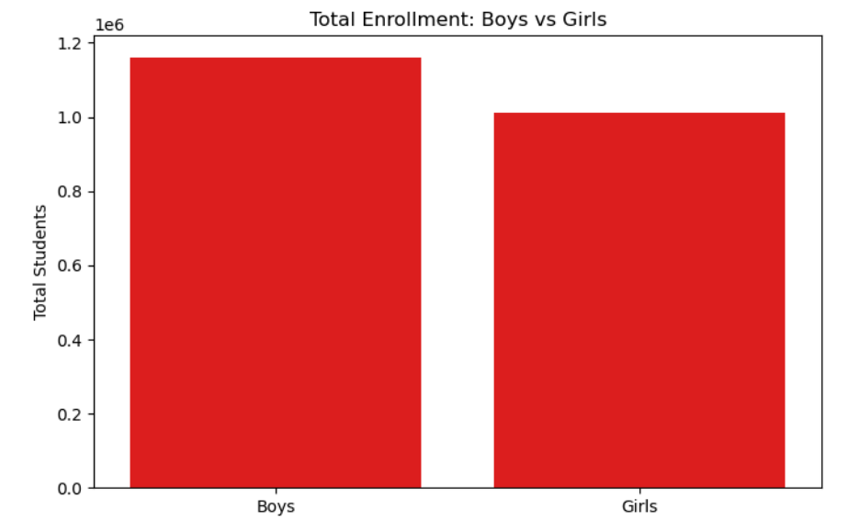
There are more boys than grils

Slide 4
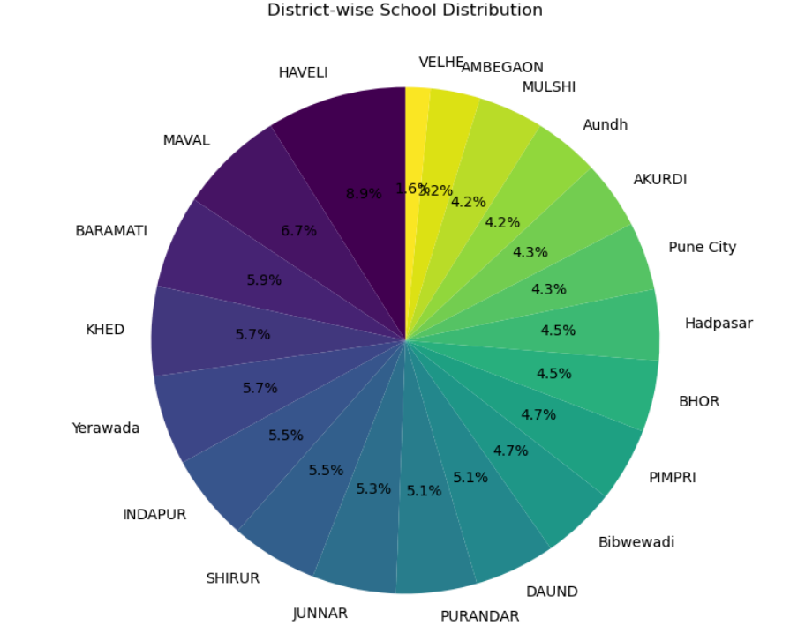
HAVELI DISTRICT HAS MORE STUDENTS

Slide 5
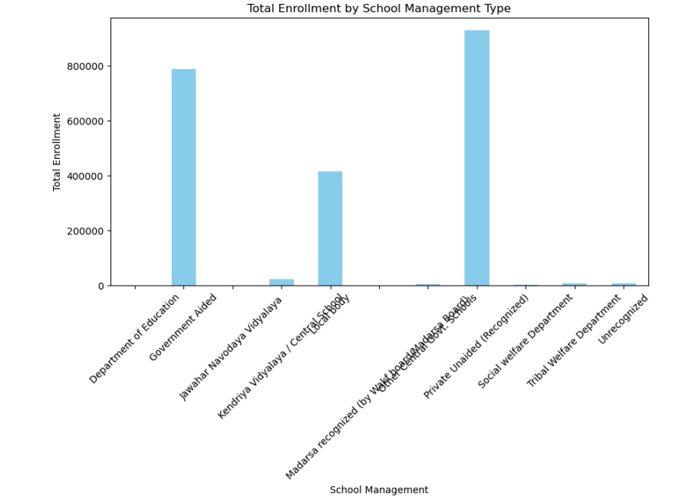
Distribution of Schools by Management Type

Slide 6
CONCLUSION:
Total Enrollment: 2,171,513 students across all schools
Gender Distribution: 1,161,483 boys and 1,010,030 girls, with a gender ratio of approximately 1.15 boys per girl.
Class-Wise Enrollment: The most populated class is Class 2 (192,592 students), while the least populated is Class 12 (118,248 students)
Pre-Primary Enrollment: 135,706 students are enrolled in pre-primary education.
School Management Distribution: The majority of students are enrolled in Private Unaided (Recognized) schools, with 928,468 students.
Rural vs Urban Enrollment: 872,442 students are enrolled in rural schools, while 1,299,071 students are in urban schools.

